Slide 1

INT247 Machine Learning Foundations
Lecture #7.0 & 7.1
LDA, Kernel PCA

Slide 2
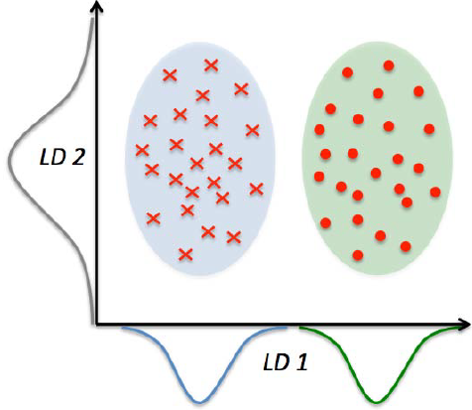
Linear Discriminant Analysis
Used for feature extraction to increase the computational efficiency and reduce the degree of over-fitting.
Finds the feature subspace that optimizes class separability.
x-axis (LD1) separate the
normally distributed classes.
y-axis (LD2) captures variance
in the dataset.

Slide 3

Steps of LDA
Standardize the d-dimensional dataset.
For each class, compute the d-dimensional mean vector.
Construct the between-class scatter matrix S_{B} and the within-class scatter matrix S_{w}.
Compute the eigenvectors and corresponding eigenvalues of the matrix ${S_{w}}_{}^{−1}$ S_{B}
Choose the k eigenvectors that correspond to the k largest eigenvalues to construct a dXk – dimensional transformation matrix W; the eigenvectors are the columns of the matrix.
Project the samples onto a new feature subspace using the transformation matrix W.

Slide 4
Steps of LDA
Standardize the d-dimensional dataset.
For each class, compute the d-dimensional mean vector.
Construct the between-class scatter matrix S_{B} and the within-class scatter matrix S_{w}.
Compute the eigenvectors and corresponding eigenvalues of the matrix ${S_{w}}_{}^{−1}$ S_{B}
Choose the k eigenvectors that correspond to the k largest eigenvalues to construct a dXk – dimensional transformation matrix W; the eigenvectors are the columns of the matrix.
Project the samples onto a new feature subspace using the transformation matrix W.

Slide 5
Kernel Trick
Given any algorithm that can be expressed solely in terms of dot products, this trick allows us to construct different nonlinear versions of it.
K(x_{i},x_{j})=Φ(x_{i})^{T}Φ(x_{j})
Compute the similarity between two high-dimensional feature vectors in the original feature space.

Slide 6

Popular Kernels
Polynomial Kernel:
$$K\left(x\left(i\right),x\left(j\right)\right)=\text{(}\text{x}\text{(}\text{i}\text{)}\text{Tx}\text{(}\text{j}\text{)}\text{+}\text{Ө}\text{)}\text{p}$$
Here, $\text{Ө}$ is the threshold and p is the power that has to be specified by the user.
Radial Basis Function:
$$k\left(x\left(i\right),x\left(j\right)\right)=exp\left[−\frac{|\left|x\left(i\right)−x\left(j\right)\right||2}{2σ2}\right]$$
Hyperbolic tangent kernal:
$$k\left(x\left(i\right),x\left(j\right)\right)=tanh(ηx\left(i\right)Tx\left(j\right)+θ)$$

Slide 7

Steps for RBF kernel PCA
Compute the kernel matrix k.
Center the kernel matrix k using the following equation:
$K^{′}=K−InK−KIn+InKIn$
Here I_{n} is an nXn-dimensional matrix where all values are equal to 1/n.
Collect the top k eigenvectors of the centered kernel matrix based on their corresponding eigenvalues, which are ranked by decreasing magnitude.

Slide 8
Advantages of Dimensionality Reduction
It helps in data compression, and hence reduced storage space.
It reduces computation time.
It also helps remove redundant features, if any.

Slide 9
Disadvantages of Dimensionality Reduction
It may lead to some amount of data loss.
PCA tends to find linear correlations between variables, which is sometimes undesirable.
PCA fails in cases where mean and covariance are not enough to define datasets.

Slide 10


